Slide 1
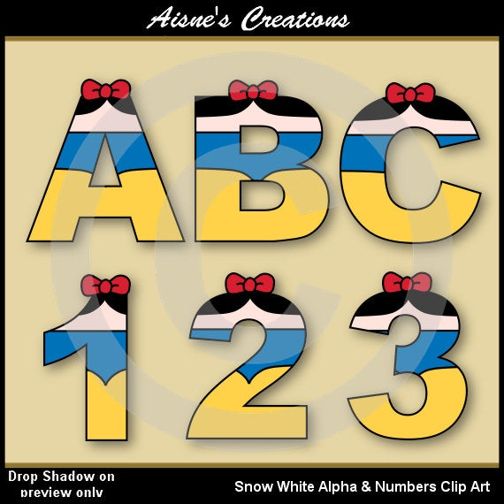
3
DESIGN, MIXED MEDIA AND TECHNOLOGY
GRAPHIC DESIGN
Developed by Charles Juma
LETTER CONSTRUCTION
Graphic design is the art of combining words and pictures to pass a message. It involves both letter construction and picture making.
Block letters are letters that have a 3 dimensional appearance 3D.
3D Letters
2D Letters

Slide 2
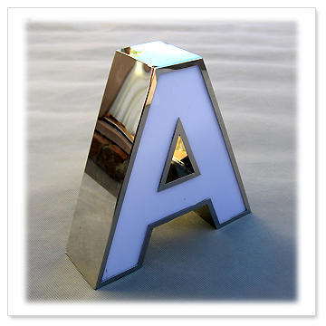
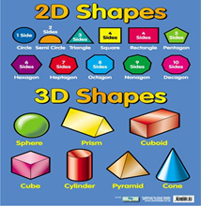
3
DESIGN, MIXED MEDIA AND TECHNOLOGY
GRAPHIC DESIGN
Developed by Charles Juma
LETTER CONSTRUCTION
Two dimensional letters or shape are those that have only height and length. They appear to be flat on the surface.
Three dimensional letters or shapes are those that have the height, the length and the width. They appear to be raised from the surface or cut out of a block.

Slide 3
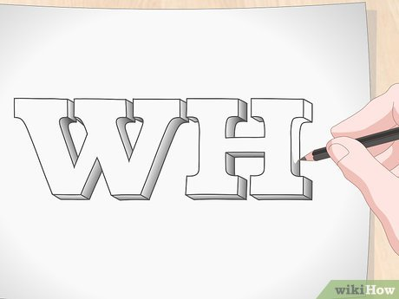
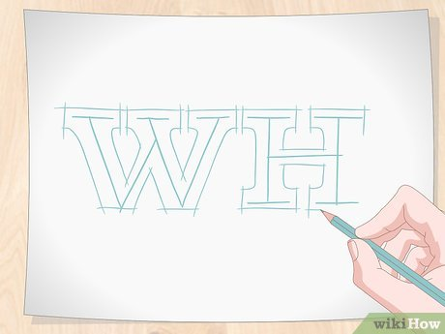
3
DESIGN, MIXED MEDIA AND TECHNOLOGY
GRAPHIC DESIGN
Developed by Charles Juma
LETTER CONSTRUCTION
3
2
1

Slide 4
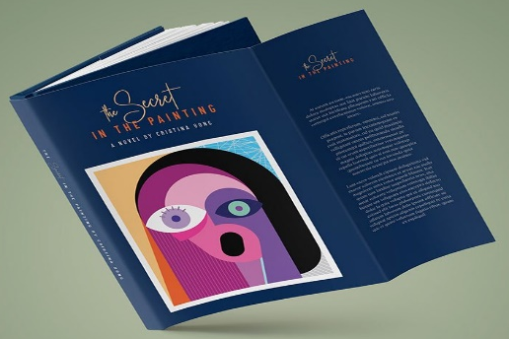
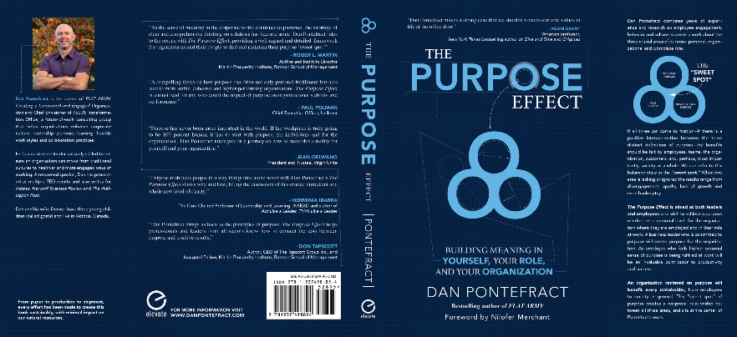
3
DESIGN, MIXED MEDIA AND TECHNOLOGY
BOOK CRAFT
Developed by Charles Juma
BOOK CRAFT
BOOK JACKET
A book jacket is a removable cover made of paper. It is used to protect the cover of the book. It gives information about;
The tittle
The author
The illustration of the picture.

Slide 5
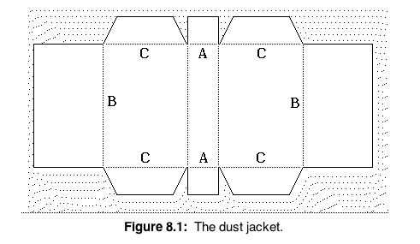
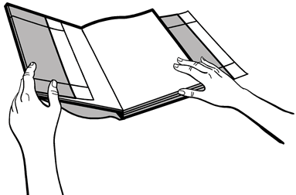
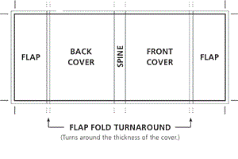
3
DESIGN, MIXED MEDIA AND TECHNOLOGY
BOOK CRAFT
Developed by Charles Juma
BOOK CRAFT
BOOK JACKET
2
How to create a book jacket.
3
1

Slide 6
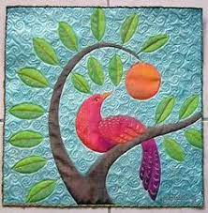
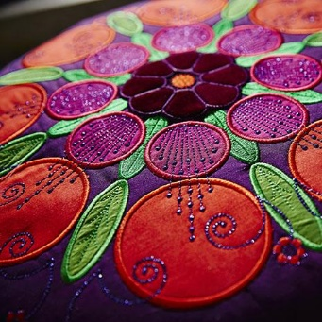
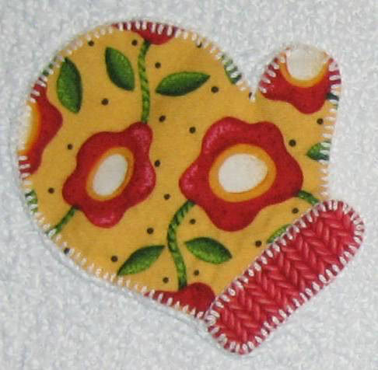
3
DESIGN, MIXED MEDIA AND TECHNOLOGY
BOOK CRAFT
Developed by Charles Juma
Apliqué decoration
This is a type of design where pieces of fabric are sewed or stuck onto another piece of fabric to form a picture or a pattern.

Slide 7
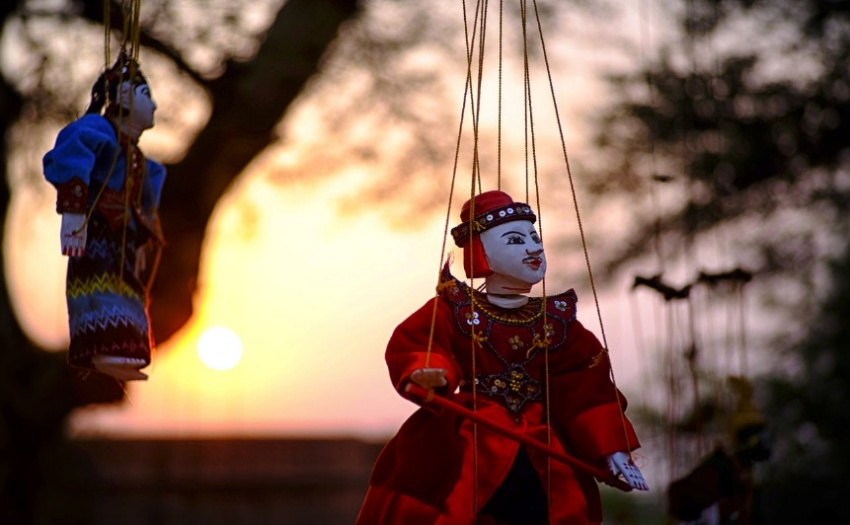
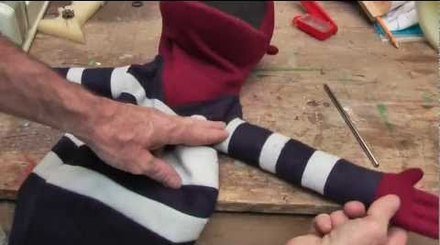
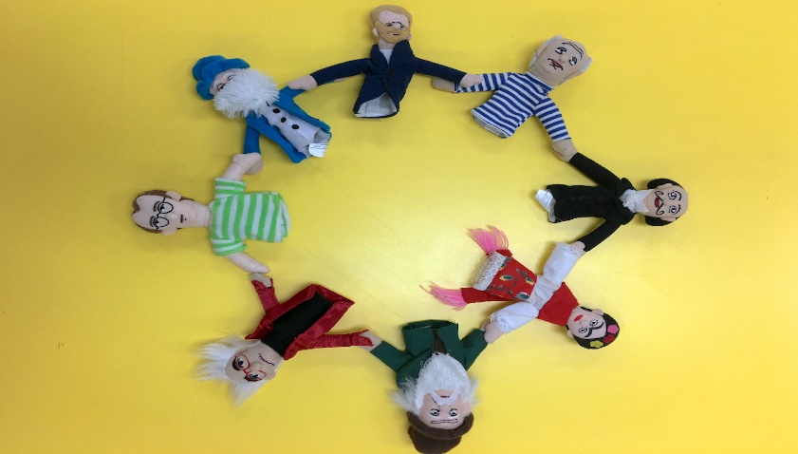
3
DESIGN, MIXED MEDIA AND TECHNOLOGY
PUPPETRY
Developed by Charles Juma
Marionette
Puppetry is the art of making and controlling the movement of puppets in a performance.
A puppet is a toy or figure in the shape of a human or an animal, that is moved by a human to make it appear like it is alive.

Slide 8
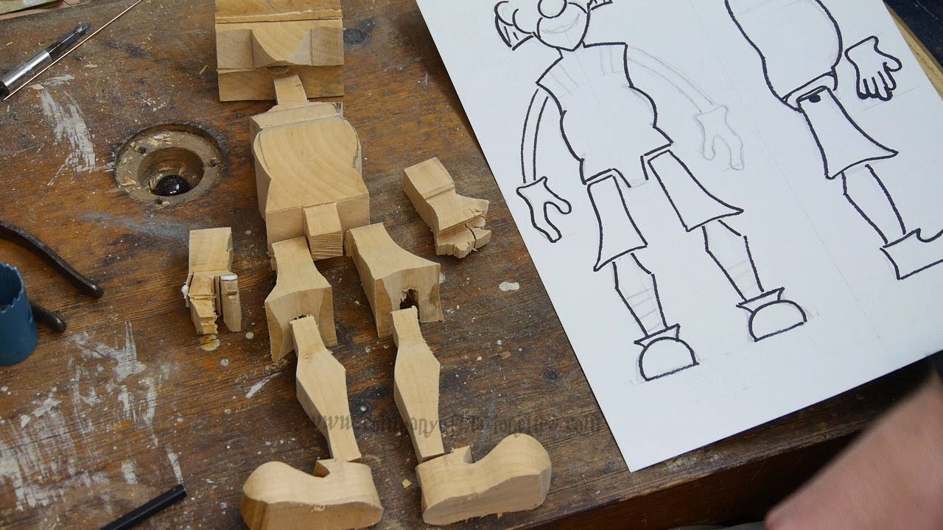
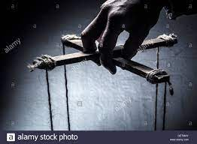
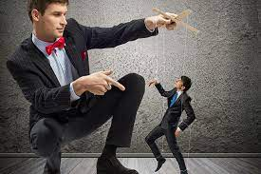
3
DESIGN, MIXED MEDIA AND TECHNOLOGY
PUPPETRY
Developed by Charles Juma
Marionette
A marionette is a toy of a person or animal controlled from above by strings attached to its movable body parts.
They are used as characters in perfomance or entertainment. The person that controls a marionette is called a marionettist.

Slide 9
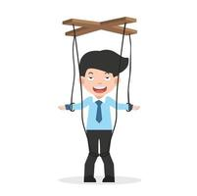
3
DESIGN, MIXED MEDIA AND TECHNOLOGY
PUPPETRY
Developed by Charles Juma
Marionette
A marionette has the following parts.
Model – this is the main puppet that may be of a human or an animal.
Handle – this is the part that the puppeteer uses to control the marionette.
Strings – these are attached from the handle to different body parts of the marionette.

Slide 10
3
DESIGN, MIXED MEDIA AND TECHNOLOGY
BOOK CRAFT
Developed by Charles Juma
BOOK CRAFT
BOOK JACKET
A book jacket is a removable cover made of paper. It is used to protect the cover of the book. It gives information about;
The tittle
The author
The illustration of the picture.

Slide 11
3
DESIGN, MIXED MEDIA AND TECHNOLOGY
BOOK CRAFT
Developed by Charles Juma
BOOK CRAFT
BOOK JACKET
2
How to create a book jacket.
3
1

Slide 12
3
DESIGN, MIXED MEDIA AND TECHNOLOGY
BOOK CRAFT
Developed by Charles Juma
Applique decoration
This is a type of design where pieces of fabric are sewed or stuck onto another piece of fabric to form a picture or a pattern.

