Slide 1
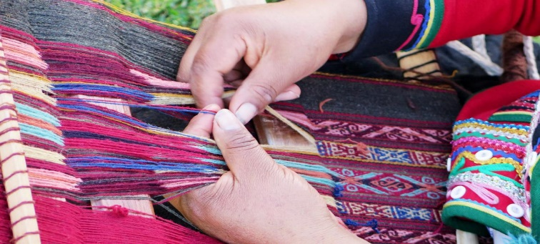
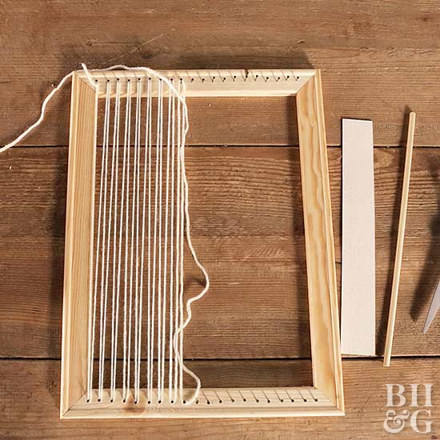
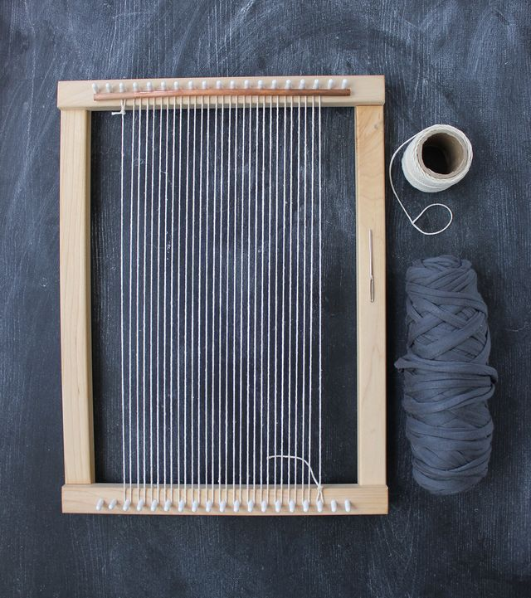
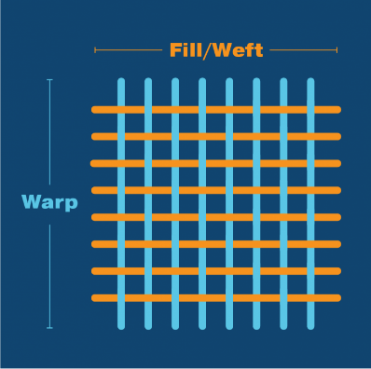
2
INDIGENOUS KENYAN CRAFTS
WEAVING
Developed by Charles Juma
PLAINANT AND TWINE TECHNIQUES
Weaving is done by passing threads over and under other threads on a loom. It is the process of interlacing warps and wefts.
A loom is a frame that holds warp threads tightly during the weaving process.
The two sets of threads used in weaving are the warp and weft. The wefts are the threads that interlace across the warp threads
warp

Slide 2
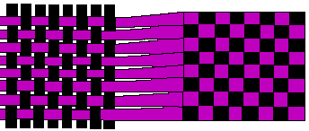
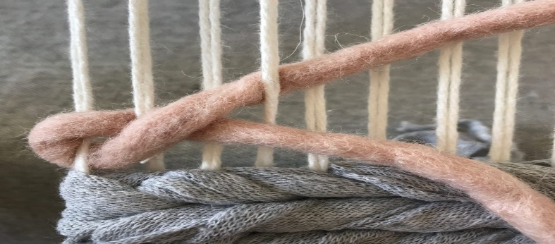
2
INDIGENOUS KENYAN CRAFTS
WEAVING
Developed by Charles Juma
PLAINANT AND TWINE TECHNIQUES
In plain weaving, the weft threads pass over one warp and another warp continuously to the end of the woven item. This is also called check weave.
In twine weave technique, two wefts are used. The two weft threads are twined or wrapped around the warp.

Slide 3
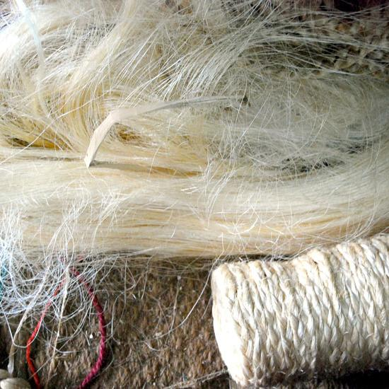
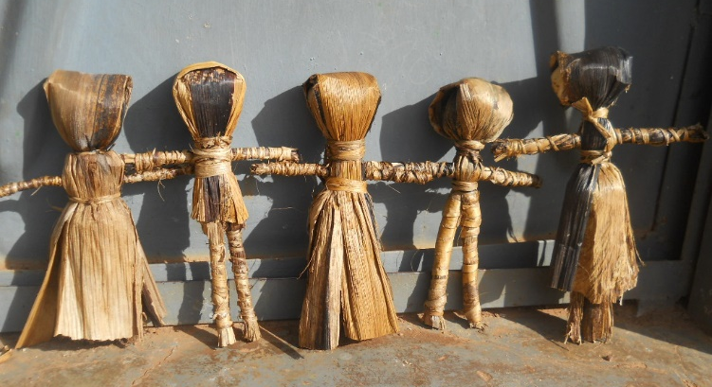
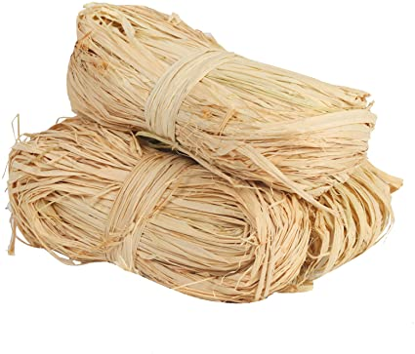
2
INDIGENOUS KENYAN CRAFTS
WEAVING
Developed by Charles Juma
PLAINANT AND TWINE TECHNIQUES
Weaving materials
Weaving materials can be obtained from plants or animals. Plant fibres include banana, sisal or cotton.
Materials from animals include wool and silk.
Some materials used in weaving are flexible while others are stiff.

Slide 4
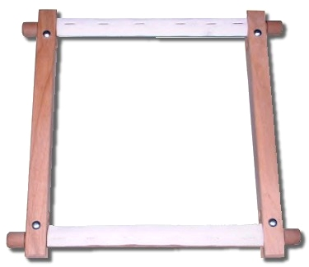
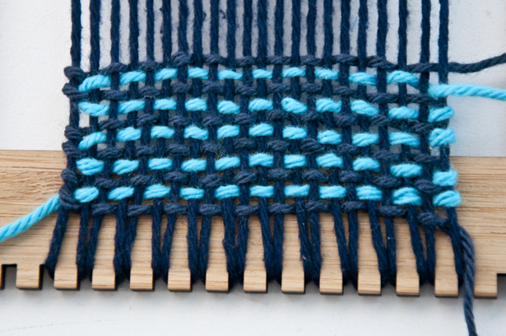
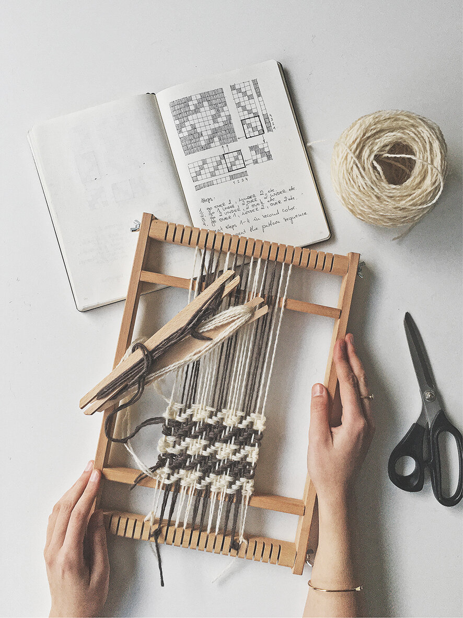
2
INDIGENOUS KENYAN CRAFTS
WEAVING
Developed by Charles Juma
PLAINANT AND TWINE TECHNIQUES
Weaving a mat in two colours
To weave a mat you need to make a loom first. This will help you to hold your warp threads tightly and to enable you to easily pass the weft threads over the warp threads.
A dowel loom is a simple type of loom that you can make and use to weave a mat.

Slide 5
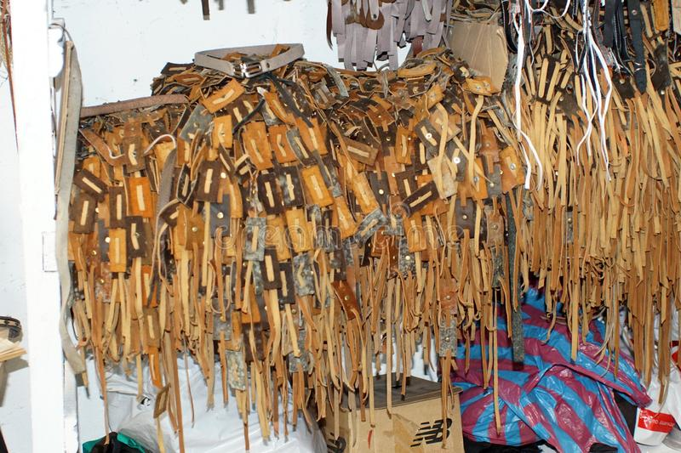
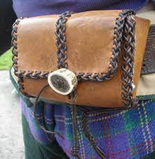
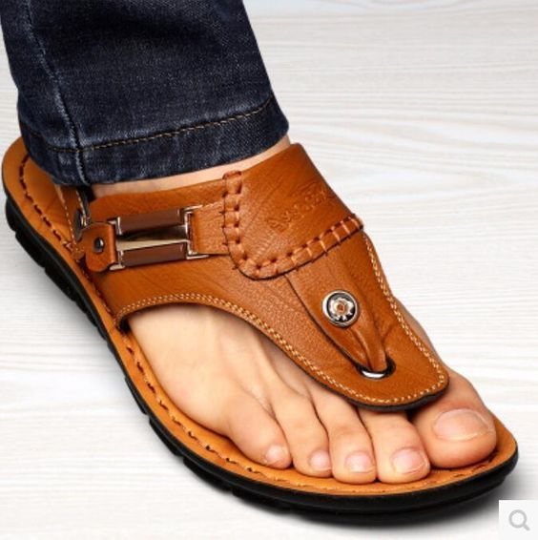
2
INDIGENOUS KENYAN CRAFTS
LEATHER WORK
Developed by Charles Juma
THONGING METHOD
Strips of leather or thongs, are used to lace or join two or more pieces of leather in the Thonging process. It is used to decorate leather items.
Leather can be obtained from animal hides and skins. They undergo the tanning process to prevent it from decomposing, rotting and removing bad smell.
Colour is also added to the leather during the tanning process.

Slide 6
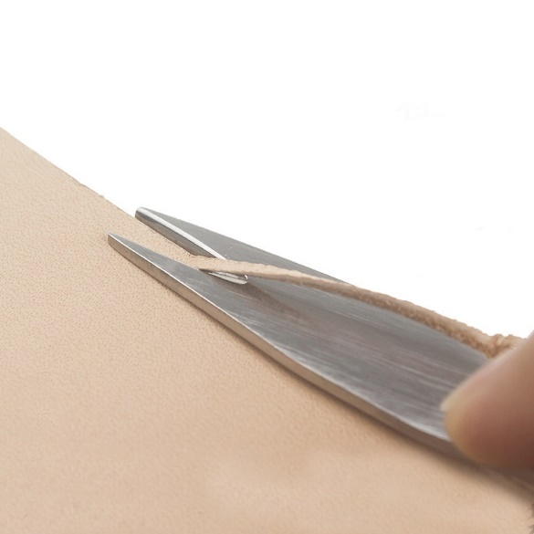
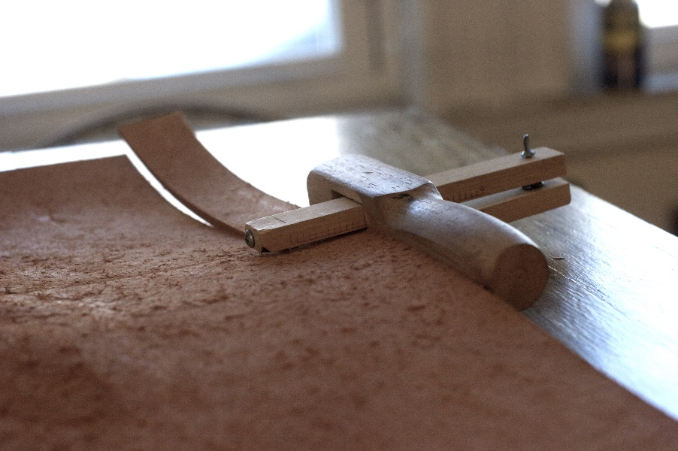
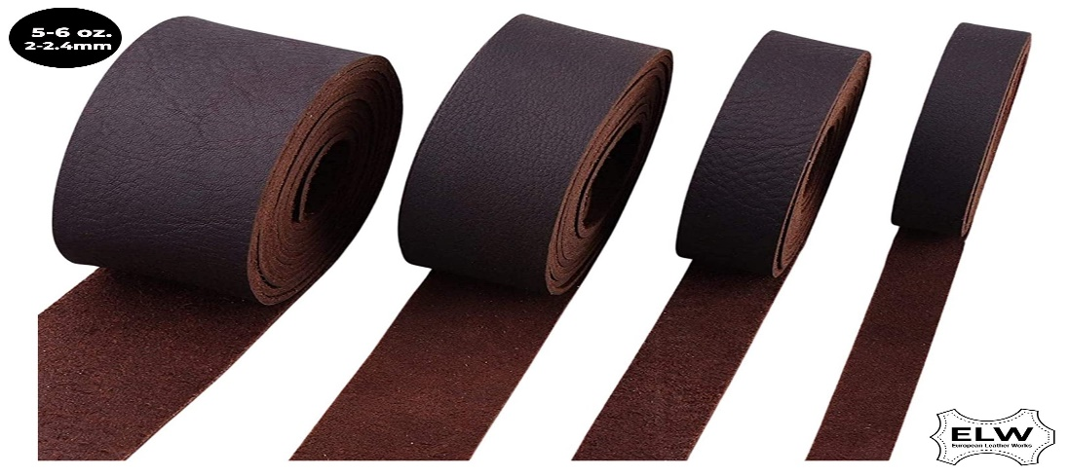
2
INDIGENOUS KENYAN CRAFTS
LEATHER WORK
Developed by Charles Juma
THONGING METHOD
Cutting leather thongs.
Draw the outline of your thongs on a leather material then cut it out using a cutting tool.

Slide 7
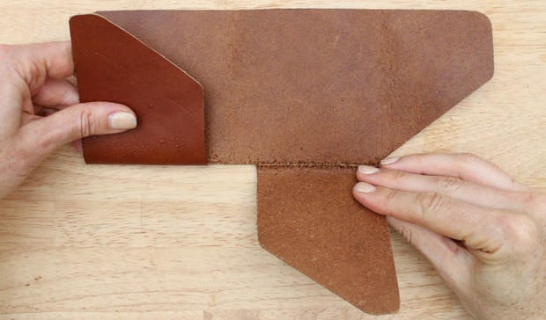
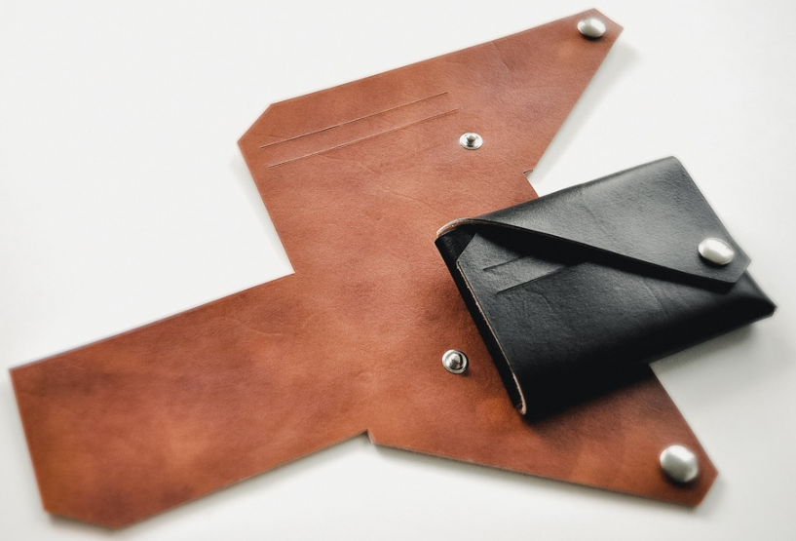
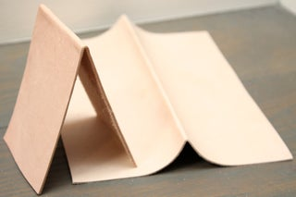
2
INDIGENOUS KENYAN CRAFTS
LEATHER WORK
Developed by Charles Juma
THONGING METHOD
Folding leather before lacing.
Fold the leather according to your drawn design. Use the appropriate tool for making holes on leather items before lacing.

Slide 8
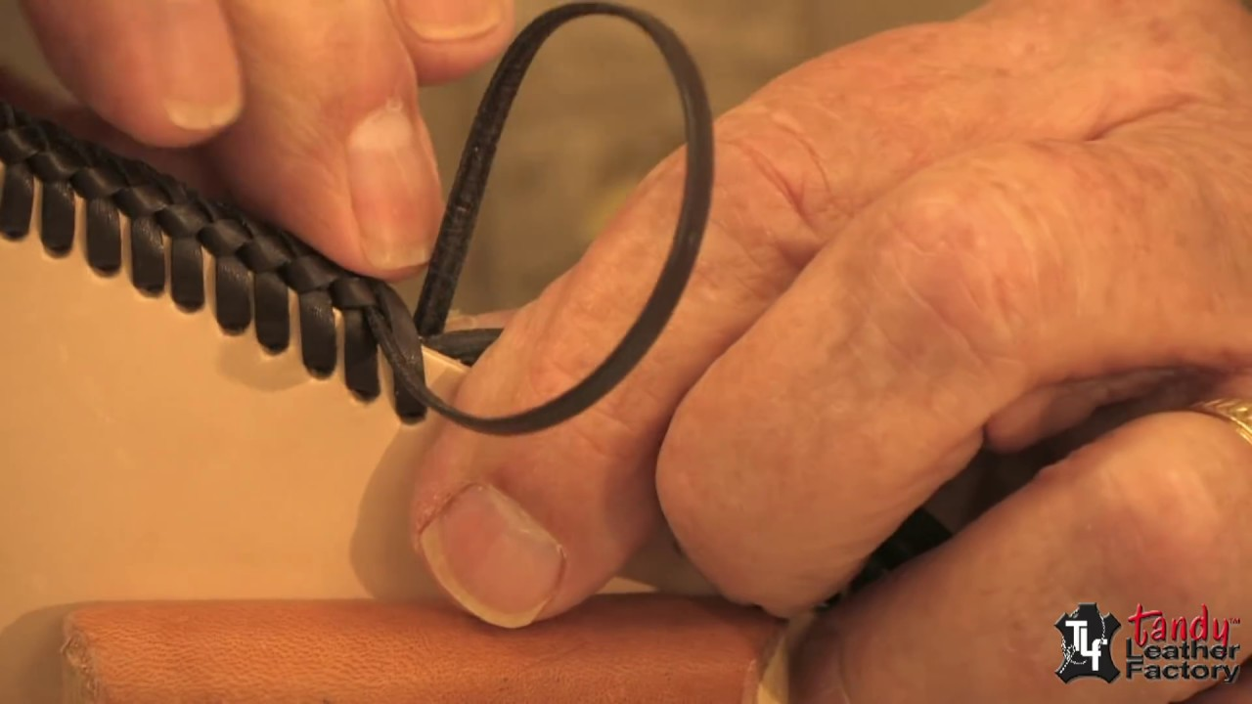
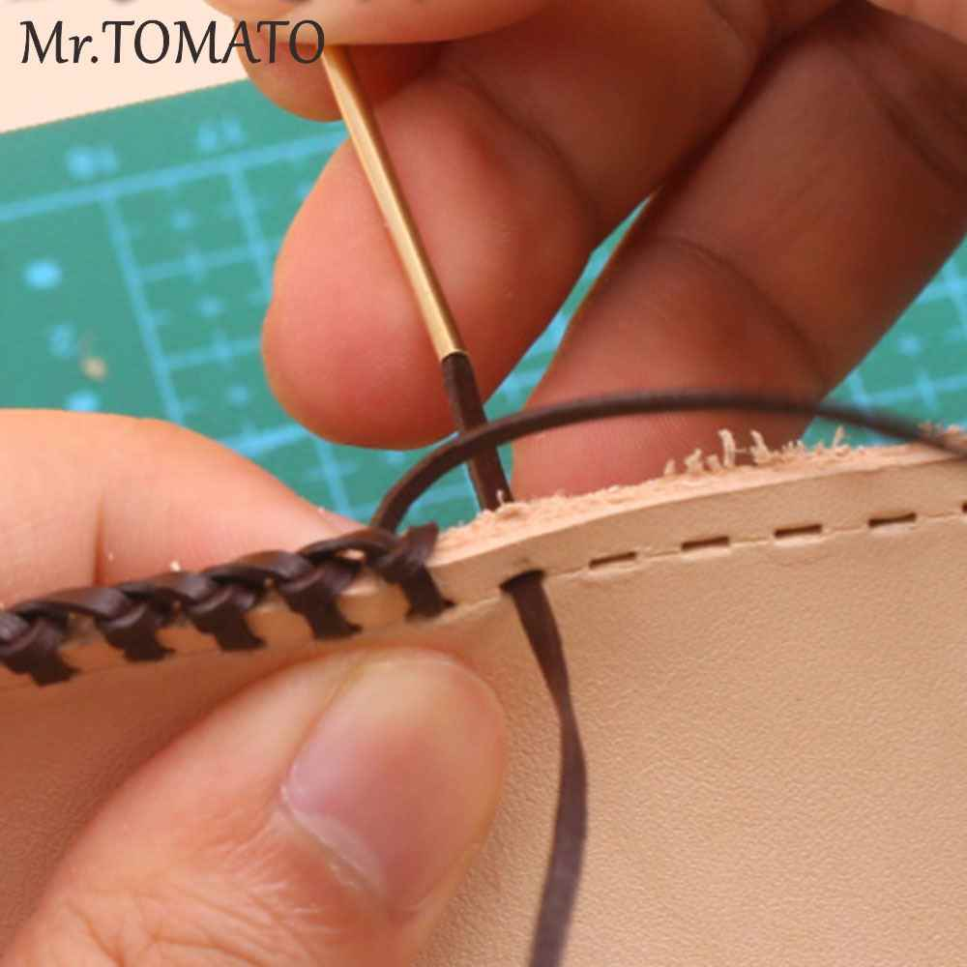
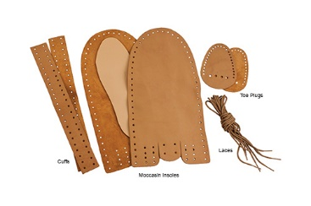
2
INDIGENOUS KENYAN CRAFTS
LEATHER WORK
Developed by Charles Juma
THONGING METHOD
Leather lacing.
Join the leather pieces using the cut strips/thongs by passing them through the hole and tighten then to be tight.

Slide 9
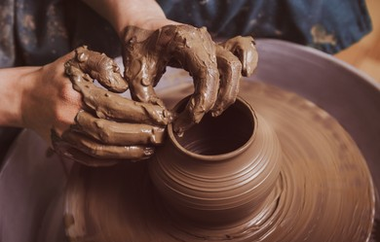
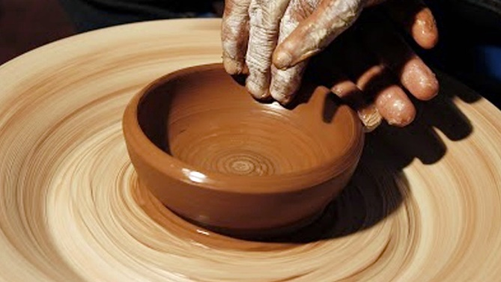
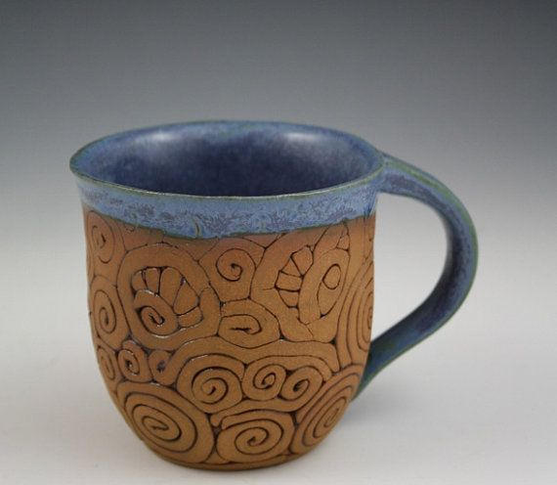
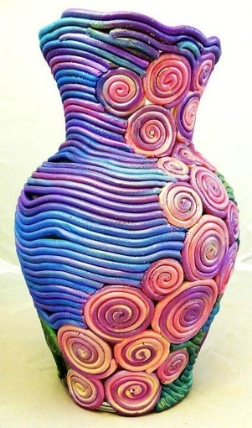
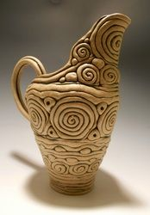
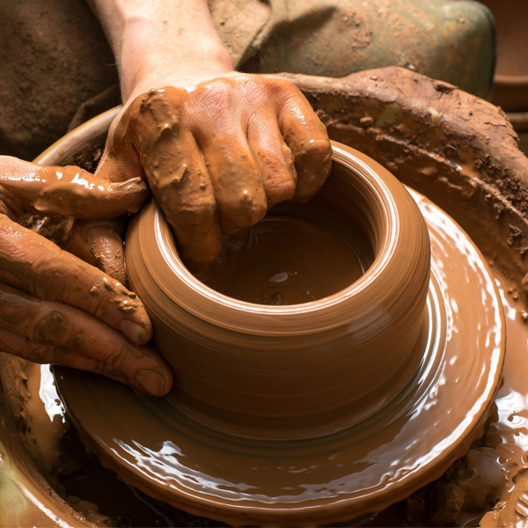
2
INDIGENOUS KENYAN CRAFTS
POTTERY
Developed by Charles Juma
THE COIL TECHNIQUE
Pottery involves modelling articles using clay such as pots. Plates, spoons, flower vases and decorative containers..
The coil technique is the process of making clay articles by rolling clay into coils to model an article.

Slide 10
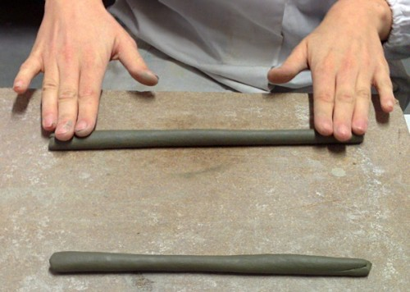
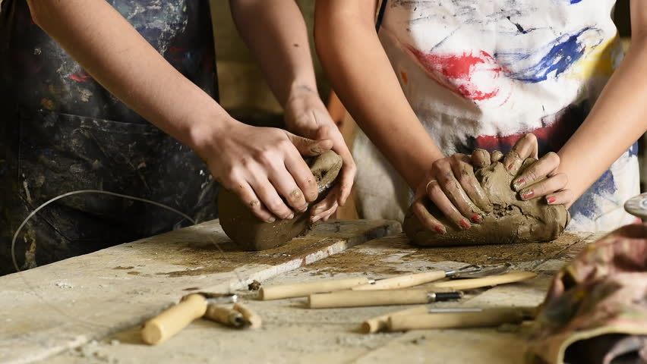
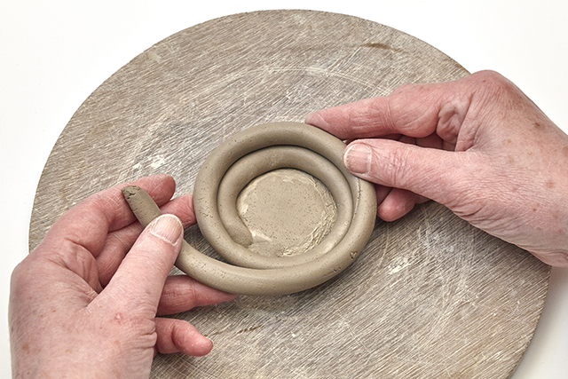
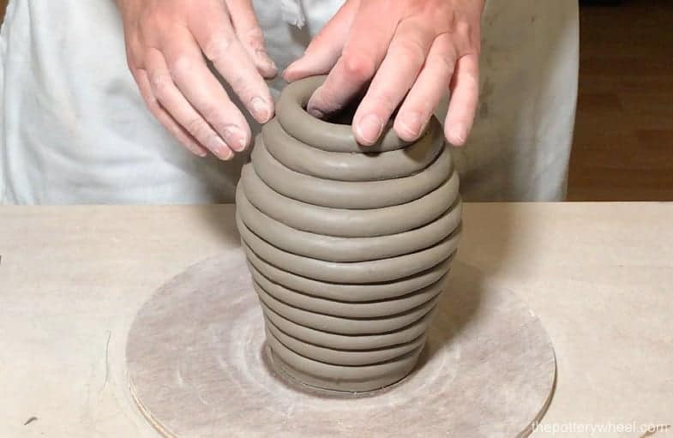
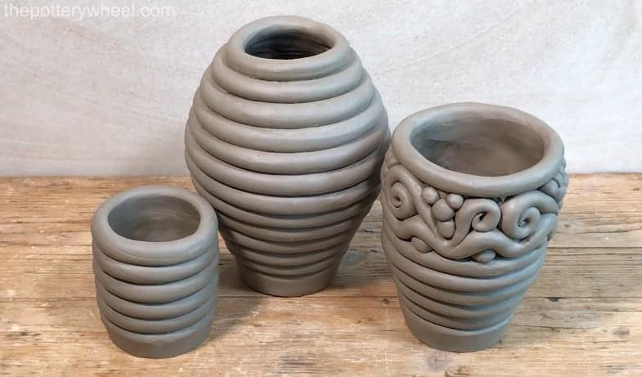
2
INDIGENOUS KENYAN CRAFTS
POTTERY
Developed by Charles Juma
THE COIL TECHNIQUE
Modelling an article using the coil technique
In modelling article, we prepare the clay by removing impurities such as leaves, roots and stones.
Knead the clay to uniform the mixture by pressing, folding and stretching.
Fix the coil on the base and build it up to model the article

Slide 11
2
INDIGENOUS KENYAN CRAFTS
POTTERY
Developed by Charles Juma
THE COIL TECHNIQUE
Modelling an article using the coil technique
In modelling article, we prepare the clay by removing impurities such as leaves, roots and stones.
Knead the clay to uniform the mixture by pressing, folding and stretching.
Fix the coil on the base and build it up to model the article

Slide 12
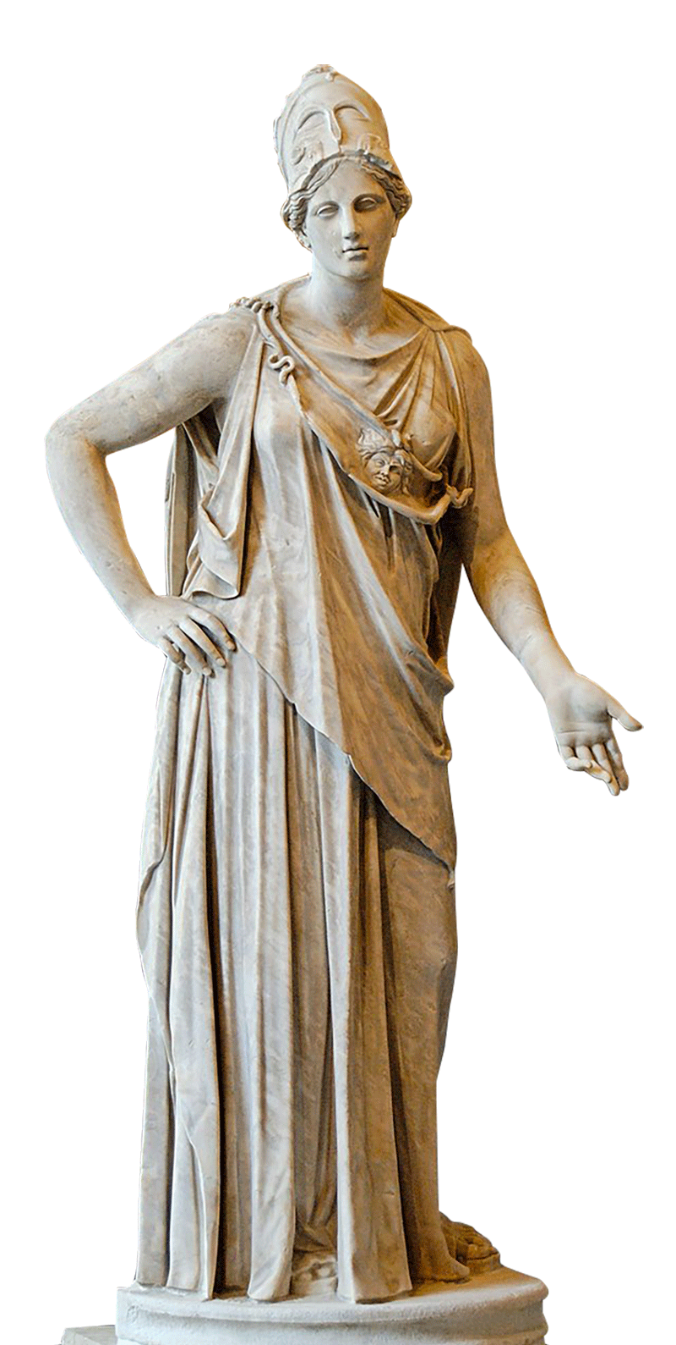
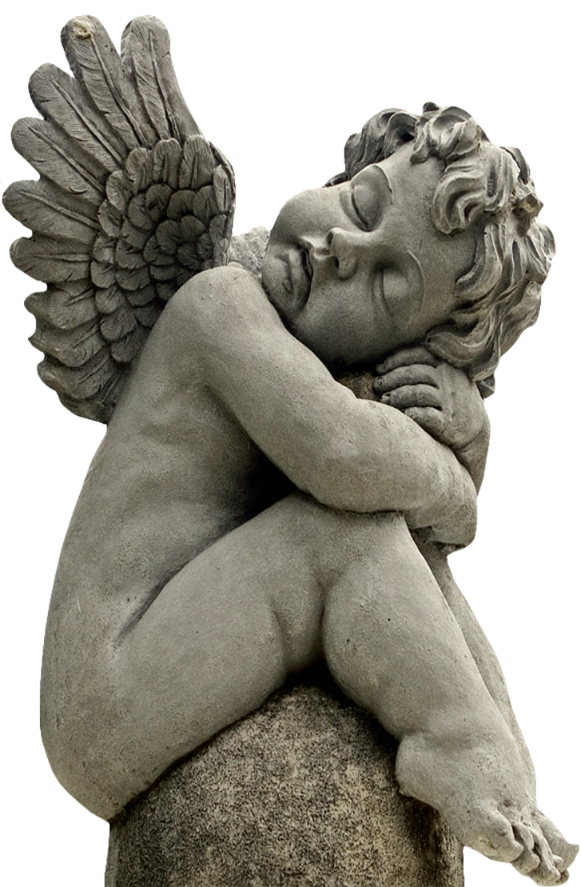
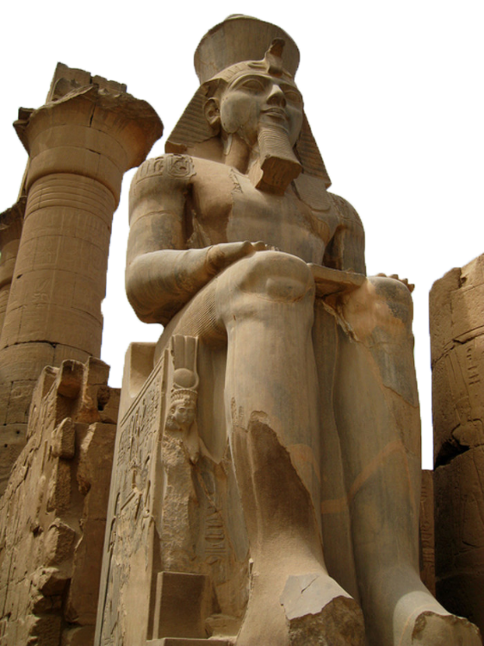
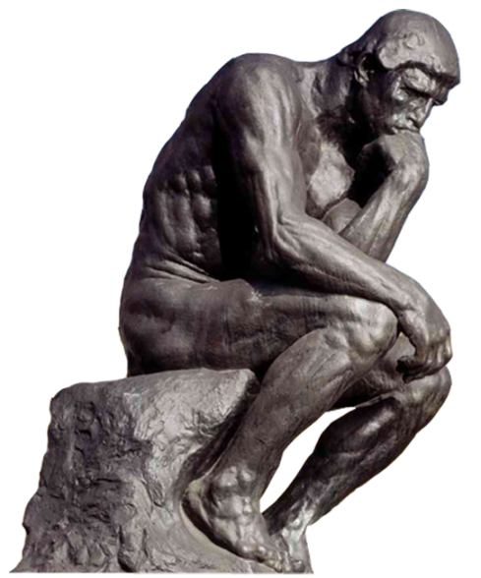
2
INDIGENOUS KENYAN CRAFTS
SCULPTURE
Developed by Charles Juma
CURVING
Sculpture involves making a three dimensional forms of objects or figures. Some of the articles made using this technique among the Kenyan community are; walking sticks, shields or masks.
Curving refers to cutting away parts from a solid material to make a desired shape.

Slide 13
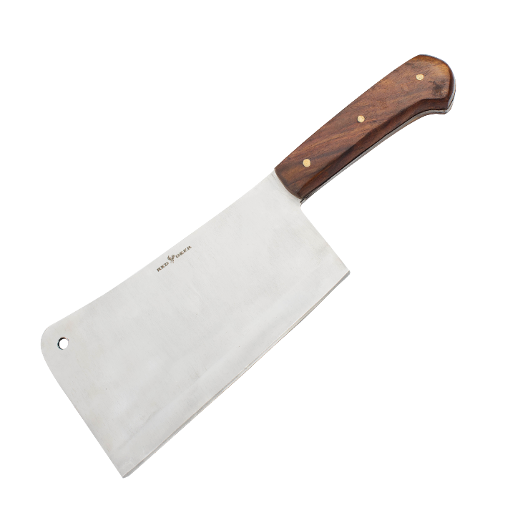
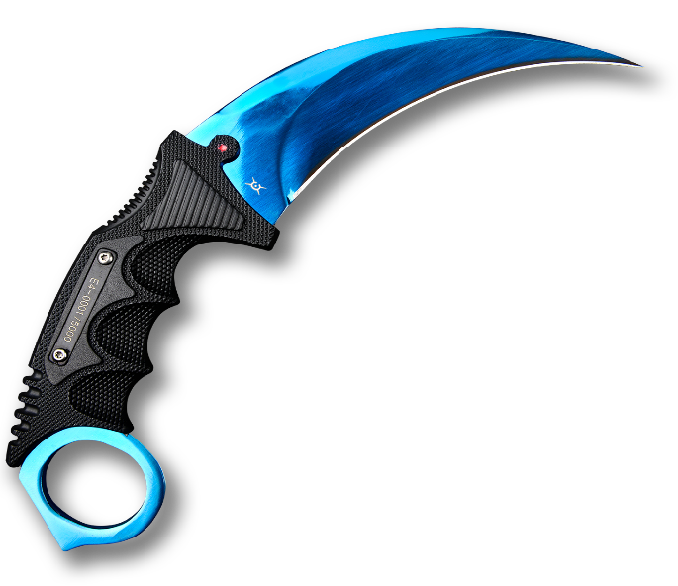
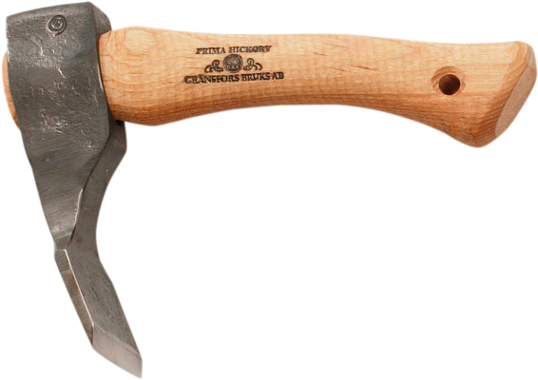
2
INDIGENOUS KENYAN CRAFTS
SCULPTURE
Developed by Charles Juma
CURVING
Curving tools and equipment.

Slide 14
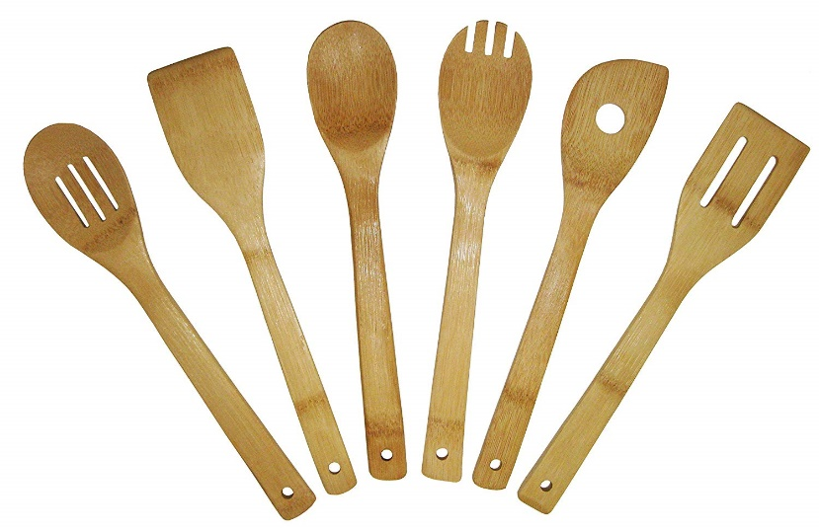
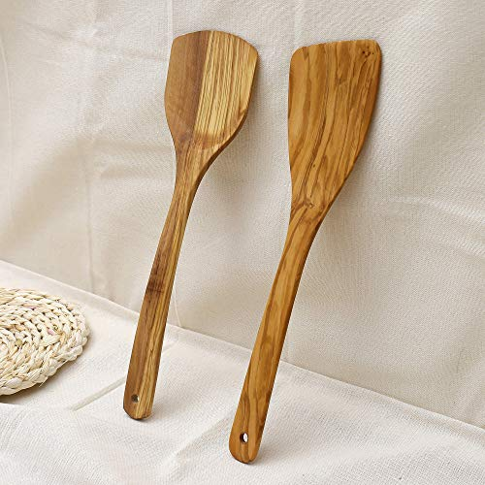
2
INDIGENOUS KENYAN CRAFTS
SCULPTURE
Developed by Charles Juma
CURVING
Curving a wooden cooking stick.

Slide 15
2
INDIGENOUS KENYAN CRAFTS
SCULPTURE
Developed by Charles Juma
CURVING
Decorating a cooking stick handle

